Slide 1
MicroKernel
A kernel is an important part of an OS that manages system resources.
A microkernel is a software or code which contains the required minimum amount of functions, data, and features to implement an operating system.
In Monolithic Kernel approach, the entire operating system runs as a single program in kernel mode
A Microkernel is the most important part for correct implementation of an operating system.

Slide 2
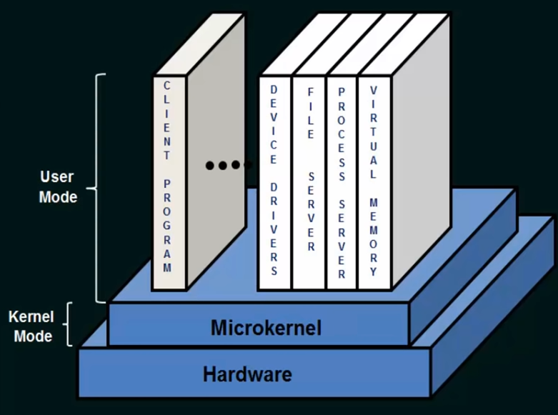
Microkernel

Slide 3
Advantages of Microkernel –
The architecture of this kernel is small and isolated hence it can function better.
Expansion of the system is easier, it is simply added in the system application without disturbing the kernel.
Microkernels are secure because only those components are included that disrupt the functionality of the system otherwise.
Microkernel interface helps you to enforce a more modular system structure.

Slide 4
Disadvantage of Microkernel
Providing services in a microkernel system are expensive compared to the normal monolithic system.
Context switch or a function call needed when the drivers are implemented as procedures or processes, respectively.
The performance of a microkernel system can be indifferent and may lead to some problems.

Slide 5
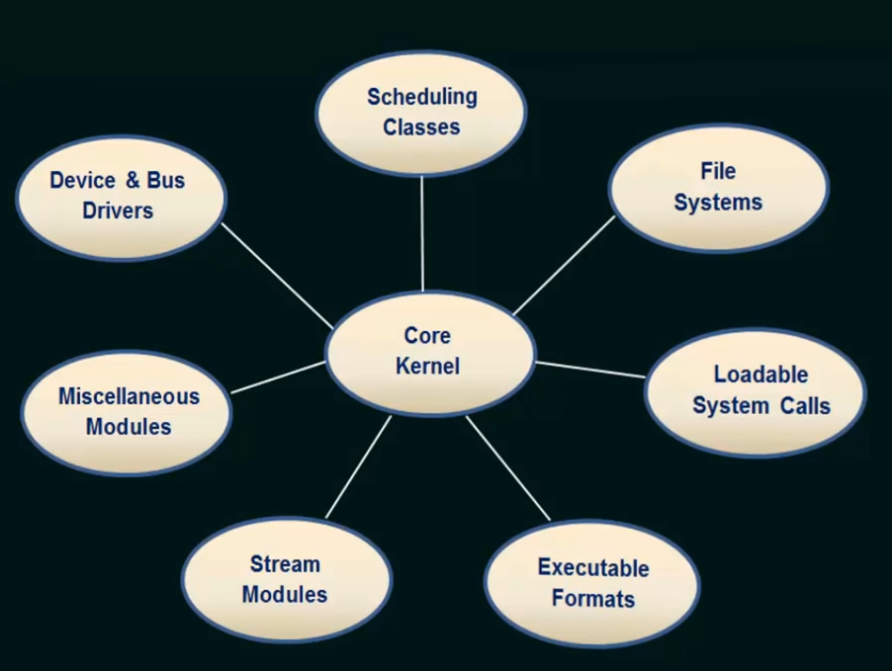
Modules Architecture

Slide 6
Modules
The best current methodology for operating-system design involves using loadable kernel modules
The kernel has a set of core components and links in additional services via modules, either at boot time or during run time.
The kernel to provide core service while other services are implemented dynamically, as the kernel is running.
More flexible than a layered system, because any module can call any other module.
More efficient than a microkernel, because modules do not need to invoke message passing in order to communicate.

Slide 7
modules
The loadable kernel modules in an operating System is an object file that contains code to extend the running kernel, which is also know as the base kernel.
The loadable kernel modules are used to add the support the files systems, hardware, system calls etc.
Her, the kernel has a set of core components and links in additional services via modules, either at boot time or during run time.
The idea of the design is for the kernel to provide core services while other services are implemented dynamically, as the kernel is running.

